Slide 1

JAWAHARLAL NEHRU NEW COLLEGE OF ENGINEERING,
DEPARTMENT OF COMPUTER SCIENCE & ENGINEERING,
SHIVAMOGGA - 577 204
PHASE - II PROJECT PRESENTATION ON:
“Melanoma Cancer Detection Using Deep Learning And Image Processing”
Team Members:
Manjunath V Poojari 4JN22CS077
Mannan Faiz 4JN22CS078
Nithish T R 4JN22CS103
Prajwal P 4JN22CS111
PROJECT CO-ORDINATORS:
Dr. BENAKAPPA S. M Ph.D. ,M.tech Asst. Professor, Dept. of CS&E
Mrs. RASHMI V M.Tech ,B.E
Asst. Professor, Dept. of CS&E
PROJECT GUIDE :
Mr.MANOHAR NELLI V B.E,M.Tech
Asst. Professor, Dept. of CS&E
JNNCE, Shivamogga
DATE :02/12/2025
TIME :11:15-11:45 AM

Slide 2

Contents
01
02
03
Abstract
Introduction
Literature Survey
04
05
06
Problem Statement
Objectives
Scope of the Project
07
08
09
Design and Implementation
Results and Discussion
Conclusion
10
11
References
Papers Published

Slide 3
Abstract
Melanoma is one of the most aggressive and fast-spreading skin cancers; early detection is critical for survival.
The project designs a deep learning–based framework to detect and classify melanoma from dermoscopic images.
The system uses image processing to enhance and normalize images, followed by Convolutional Neural Networks (CNNs) for feature extraction and lesion classification.
The model is trained on a labeled dataset containing benign and malignant skin lesions to support reliable diagnosis.
The goal is to provide a scalable clinical decision-support tool, including mobile deployment using lightweight models like MobileNet for use in remote regions.

Slide 4
Introduction
Melanoma is one of the most dangerous skin cancers and requires early detection to prevent rapid spreading.
Traditional diagnosis using dermoscopic images is subjective and depends heavily on dermatologist expertise.
Deep Learning provides automated and consistent analysis for identifying melanoma more accurately.
Image Processing techniques such as segmentation, noise/hair removal, and contrast enhancement improve lesion visibility.
A CNN-based model is used to learn features like color, borders, and texture for melanoma classification.
The system aims to act as a clinical decision-support tool, reducing diagnostic errors and speeding up detection.
Designed for mobile/web deployment, making melanoma screening accessible even in remote areas.

Slide 5
Literature Survey
1)Melanlysis: A Mobile Deep Learning Approach for Early Detection of Skin Cancer
Authors: Samen Anjum Arani, Yu Zhang, Md Tanvir Rahman, Hui Yang
Year of Publication: 2020
Methodology
Uses EfficientNetLite-0 for melanoma vs non-melanoma classification.
Applies WGAN-based augmentation to balance dataset.
Deploys model on Android via TensorFlow Lite.
Contributions
Proposes a complete mobile melanoma detection system ("Melanlysis").
Shows WGAN improves minority class representation.
Demonstrates on-device, privacy-focused melanoma detection.
Advantages
Low-latency real-time performance.
Works fully offline, ensures data privacy.
Achieves high accuracy (~94%).
Limitations
Only binary classification supported.
Evaluation limited to public datasets (not clinical).
Generalization to real-world images not fully tested.

Slide 6
2)Hybrid Deep Learning Framework for Melanoma Diagnosis Using Dermoscopic Medical Images
Authors: Muhammad Mateen, Shaukat Hayat, Fizzah Arshad, Yeong-Hyeon Gu, Mugahed A. Al-Antari
Year of Publication: 2024
Methodology
Uses U-Net for segmentation.
Inception-ResNet-V2 for deep feature extraction.
Vision Transformer (ViT) for final classification.
Contributions
Introduces a powerful three-stage hybrid model.
Performs extensive ablation studies.
Achieves 98.65% accuracy with strong sensitivity.
Advantages
High clinical-grade performance.
Segmentation improves focus on lesion region.
Transformer improves global context understanding.
Limitations
Very high computational cost.
Hard to deploy on mobile/low-end systems.
Requires large datasets and GPUs.

Slide 7
3)Skin Cancer Detection Using Deep Machine Learning Techniques
Authors: Olusoji Akinrinade, Chunglin Du
Year of Publication: 2025
Methodology
Evaluates CNN, ANN, GANs, transfer learning.
Uses synthetic GAN data for imbalance.
Explores few-shot and hybrid learning.
Contributions
Provides a broad analysis of DL methods for melanoma detection.
Shows GANs improve minority class performance.
Discusses challenges of small datasets.
Advantages
Covers multiple model architectures.
Addresses limited-data scenarios with GANs.
Provides strong design insights for CAD systems.
Limitations
Does not focus on one deployable model.
Limited performance comparison depth.
Complex methods may be hard to reproduce.

Slide 8
4)Hybrid Deep Learning Model for Skin Cancer Classification
Author: Dr. Irala Suneetha
Year of Publication: 2024
Methodology
Combines VGG16 and InceptionV3 feature extractors.
Preprocesses dermoscopic images (resizing, noise removal).
Trains hybrid model using standard metrics.
Contributions
Shows hybrid CNN improves accuracy over single models.
Demonstrates complementary global + local feature learning.
Provides performance comparison with traditional ML.
Advantages
Higher robustness in multi-class classification.
No manual feature engineering needed.
Strong baseline for skin-cancer CAD systems.
Limitations
Larger and heavier model → slow to train.
Real-time/mobile deployment not optimised.
Computation requirement is high.

Slide 9
5)Hybrid Deep Learning Framework for Enhanced Melanoma Detection
Authors: Peng Zhang, Divya Chaudhary
Year of Publication: 2024
Methodology
U-Net for lesion segmentation using HAM10000.
EfficientNet-B0 classifier trained on ISIC 2020.
Segmentation mask blended with original image.
Contributions
Introduces a hybrid segmentation + classification pipeline.
Achieves strong performance (~99% accuracy).
Highlights the benefit of focusing on lesion region.
Advantages
High accuracy and strong robustness.
Segmentation reduces background interference.
Better boundary detection and feature clarity.
Limitations
Two-stage pipeline increases complexity.
Not optimised for mobile devices.
Requires large compute for training.

Slide 10
6) Deep Learning for Melanoma Detection: A Deep Learning Approach to Differentiating Malignant Melanoma from Benign
Melanocytic Nevi
Authors: Magdalini Kreouzi, Nikolaos Theodorakis, Georgios Feretzakis, Evgenia Paxinou, Aikaterini Sakagianni, Dimitris Kalles, Athanasios Anastasiou, Vassilios S. Verykios, Maria Nikolaou
Year of Publication: 2025
Methodology
Compared DenseNet121, ResNet50V2, MobileNetV2, NASNetMobile on DermNet images.
Applied augmentation, pretrained weights & binary classification setup.
Contributions
Showed DenseNet121 and ResNet50V2 achieved highest accuracy and AUC.
Highlighted suitability of MobileNetV2 for mobile/edge deployment.
Advantages
Strong benchmarking of modern CNN models.
Provides insights into balancing accuracy vs efficiency.
Limitations
Dataset limited to two classes only (melanoma & nevus).
Models may not generalize to multi-class real-world settings.

Slide 11
7)Melanoma Detection Using Deep Learning-Based Classifications
Authors: Ghadah Alwakid, Walaa Gouda, Mamoona Humayun, Najm Us Sama
Year of Publication: 2022
Methodology
Enhanced images using ESRGAN for super-resolution.
Applied segmentation + CNN + modified ResNet50.
Balanced dataset with augmentation and tested HAM10000 dataset.
Contributions
Introduced ESRGAN-based enhancement for clearer lesion edges.
Improved classification accuracy by combining segmentation and DL.
Advantages
High accuracy (0.86 F-score) with improved preprocessing.
Segmentation provides more meaningful lesion regions for CNN.
Limitations
ESRGAN increases training time significantly.
Multi-class dataset imbalance affects minority class performance.

Slide 12
8)Melanoma Detection Based on Deep Learning Networks
Authors: Sanjay Devaraneni
Year of Publication: 2023
Methodology
Used ResNet50 with transfer learning for melanoma classification.
Addressed class imbalance through augmentation.
Tuned hyperparameters (learning rate, depth).
Contributions
Demonstrated 91.70% accuracy with optimized ResNet50.
Provided detailed experiments explaining impact of learning rate & depth.
Advantages
Stable model performance with transfer learning.
Clear experimental analysis guides future model tuning.
Limitations
Model performance highly sensitive to hyperparameters.
ResNet50 has higher computational cost than lightweight networks.

Slide 13
9)Developing an Efficient Method for Melanoma Detection Using CNN Techniques
Authors: Devika Moturi, Ravi Kishan Surapaneni, Venkata Sai Geethika Avanigadda
Year of Publication: 2024
Methodology
Used HAM10000 dermoscopic images for melanoma vs non-melanoma classification.
Applied MobileNetV2, DenseNet, and a customized CNN.
Conducted preprocessing, scaling, and training multiple deep CNN models.
Contributions
Introduced a custom CNN that outperformed lightweight models.
Built a GUI-based web application for real-time melanoma prediction.
Advantages
High accuracy (95%) with optimized CNN.
Simple architecture suitable for deployment through a web app.
Limitations
Limited dataset diversity leads to class imbalance.
High-resolution images increased computation time.

Slide 14
10)Minimal Sourced and Lightweight Federated Transfer Learning Models for Skin Cancer Detection
Authors: Vikas Khullar, Prabhjot Kaur, Shubham Gargrish, Anand Muni Mishra, Prabhishek Singh, Manoj Diwakar, Anchit Bijalwan, Indrajeet Gupta
Year of Publication: 2025
Methodology
Evaluated EfficientNetV2S, EfficientNetB3, ResNet50, NASNetMobile for classification.
Implemented federated learning with both IID and Non-IID datasets.
Used low-resolution images (32×32) to reduce resource usage.
Contributions
Proposed a lightweight federated learning pipeline for melanoma detection.
Demonstrated high accuracy even with low-pixel images and decentralized data.
Advantages
Efficient for low-resource and privacy-sensitive environments.
Federated learning reduces data-sharing risks.
Limitations
Low-pixel images reduce fine lesion detail.
Federated model performance varies with client distribution.

Slide 15
PROBLEM STATEMENT
Melanoma is one of the most dangerous types of skin cancer, known for its rapid progression and high mortality when not detected early. Traditional diagnosis depends heavily on dermatologists visually examining dermoscopic images, which can lead to inconsistencies due to human fatigue, limited expertise, or subjective judgment. In many regions, especially rural areas, there is also a shortage of trained specialists, resulting in delayed diagnosis and increased risk for patients. Furthermore, variations in lighting, image quality, and skin types make manual evaluation even more challenging. These limitations highlight the need for an automated, accurate, and accessible melanoma detection system that can analyze dermoscopic images consistently and support clinicians in early decision-making.

Slide 16
Objectives
To design and implement a deep learning–based system capable of detecting melanoma from dermoscopic images.
To apply image processing techniques to enhance image quality and improve lesion feature extraction.
To develop and train a CNN model that accurately classifies melanoma vs non-melanoma lesions.
To evaluate the system's performance using standard metrics such as accuracy, precision, recall, and F1-score.
To deploy the trained model as a user-friendly web or mobile application for real-time predictions.
To build a reliable diagnostic support tool that assists dermatologists, especially in resource-limited regions.

Slide 17
Scope of the Project
1. Image Acquisition & Preprocessing Includes collection of dermoscopic images, resizing, noise/hair removal, normalization, and contrast enhancement to prepare images for model training.
2. Deep Learning Model Development Covers the design, training, and optimization of a CNN-based melanoma classifier using augmented and preprocessed datasets.
3. Performance Evaluation Focuses on testing the model using metrics like accuracy, precision, recall, F1-score, and confusion matrix to assess reliability.

Slide 18
Scope of the Project
4. System Deployment Involves converting the model to TensorFlow Lite for mobile deployment and integrating it into a web/mobile interface for real-time user access.
5. User Interaction & Output Enables users to upload images and receive melanoma predictions with confidence scores in a clean, easy-to-understand format.
6. Healthcare Support Utility Provides additional support to dermatologists as a second opinion tool and increases accessibility in regions with limited specialist availability.

Slide 19
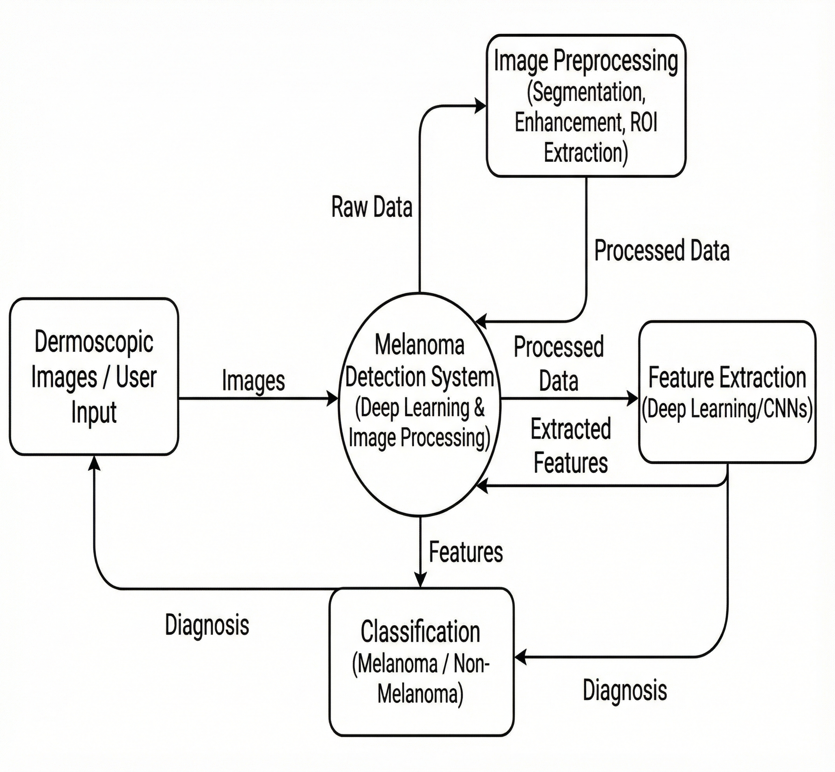
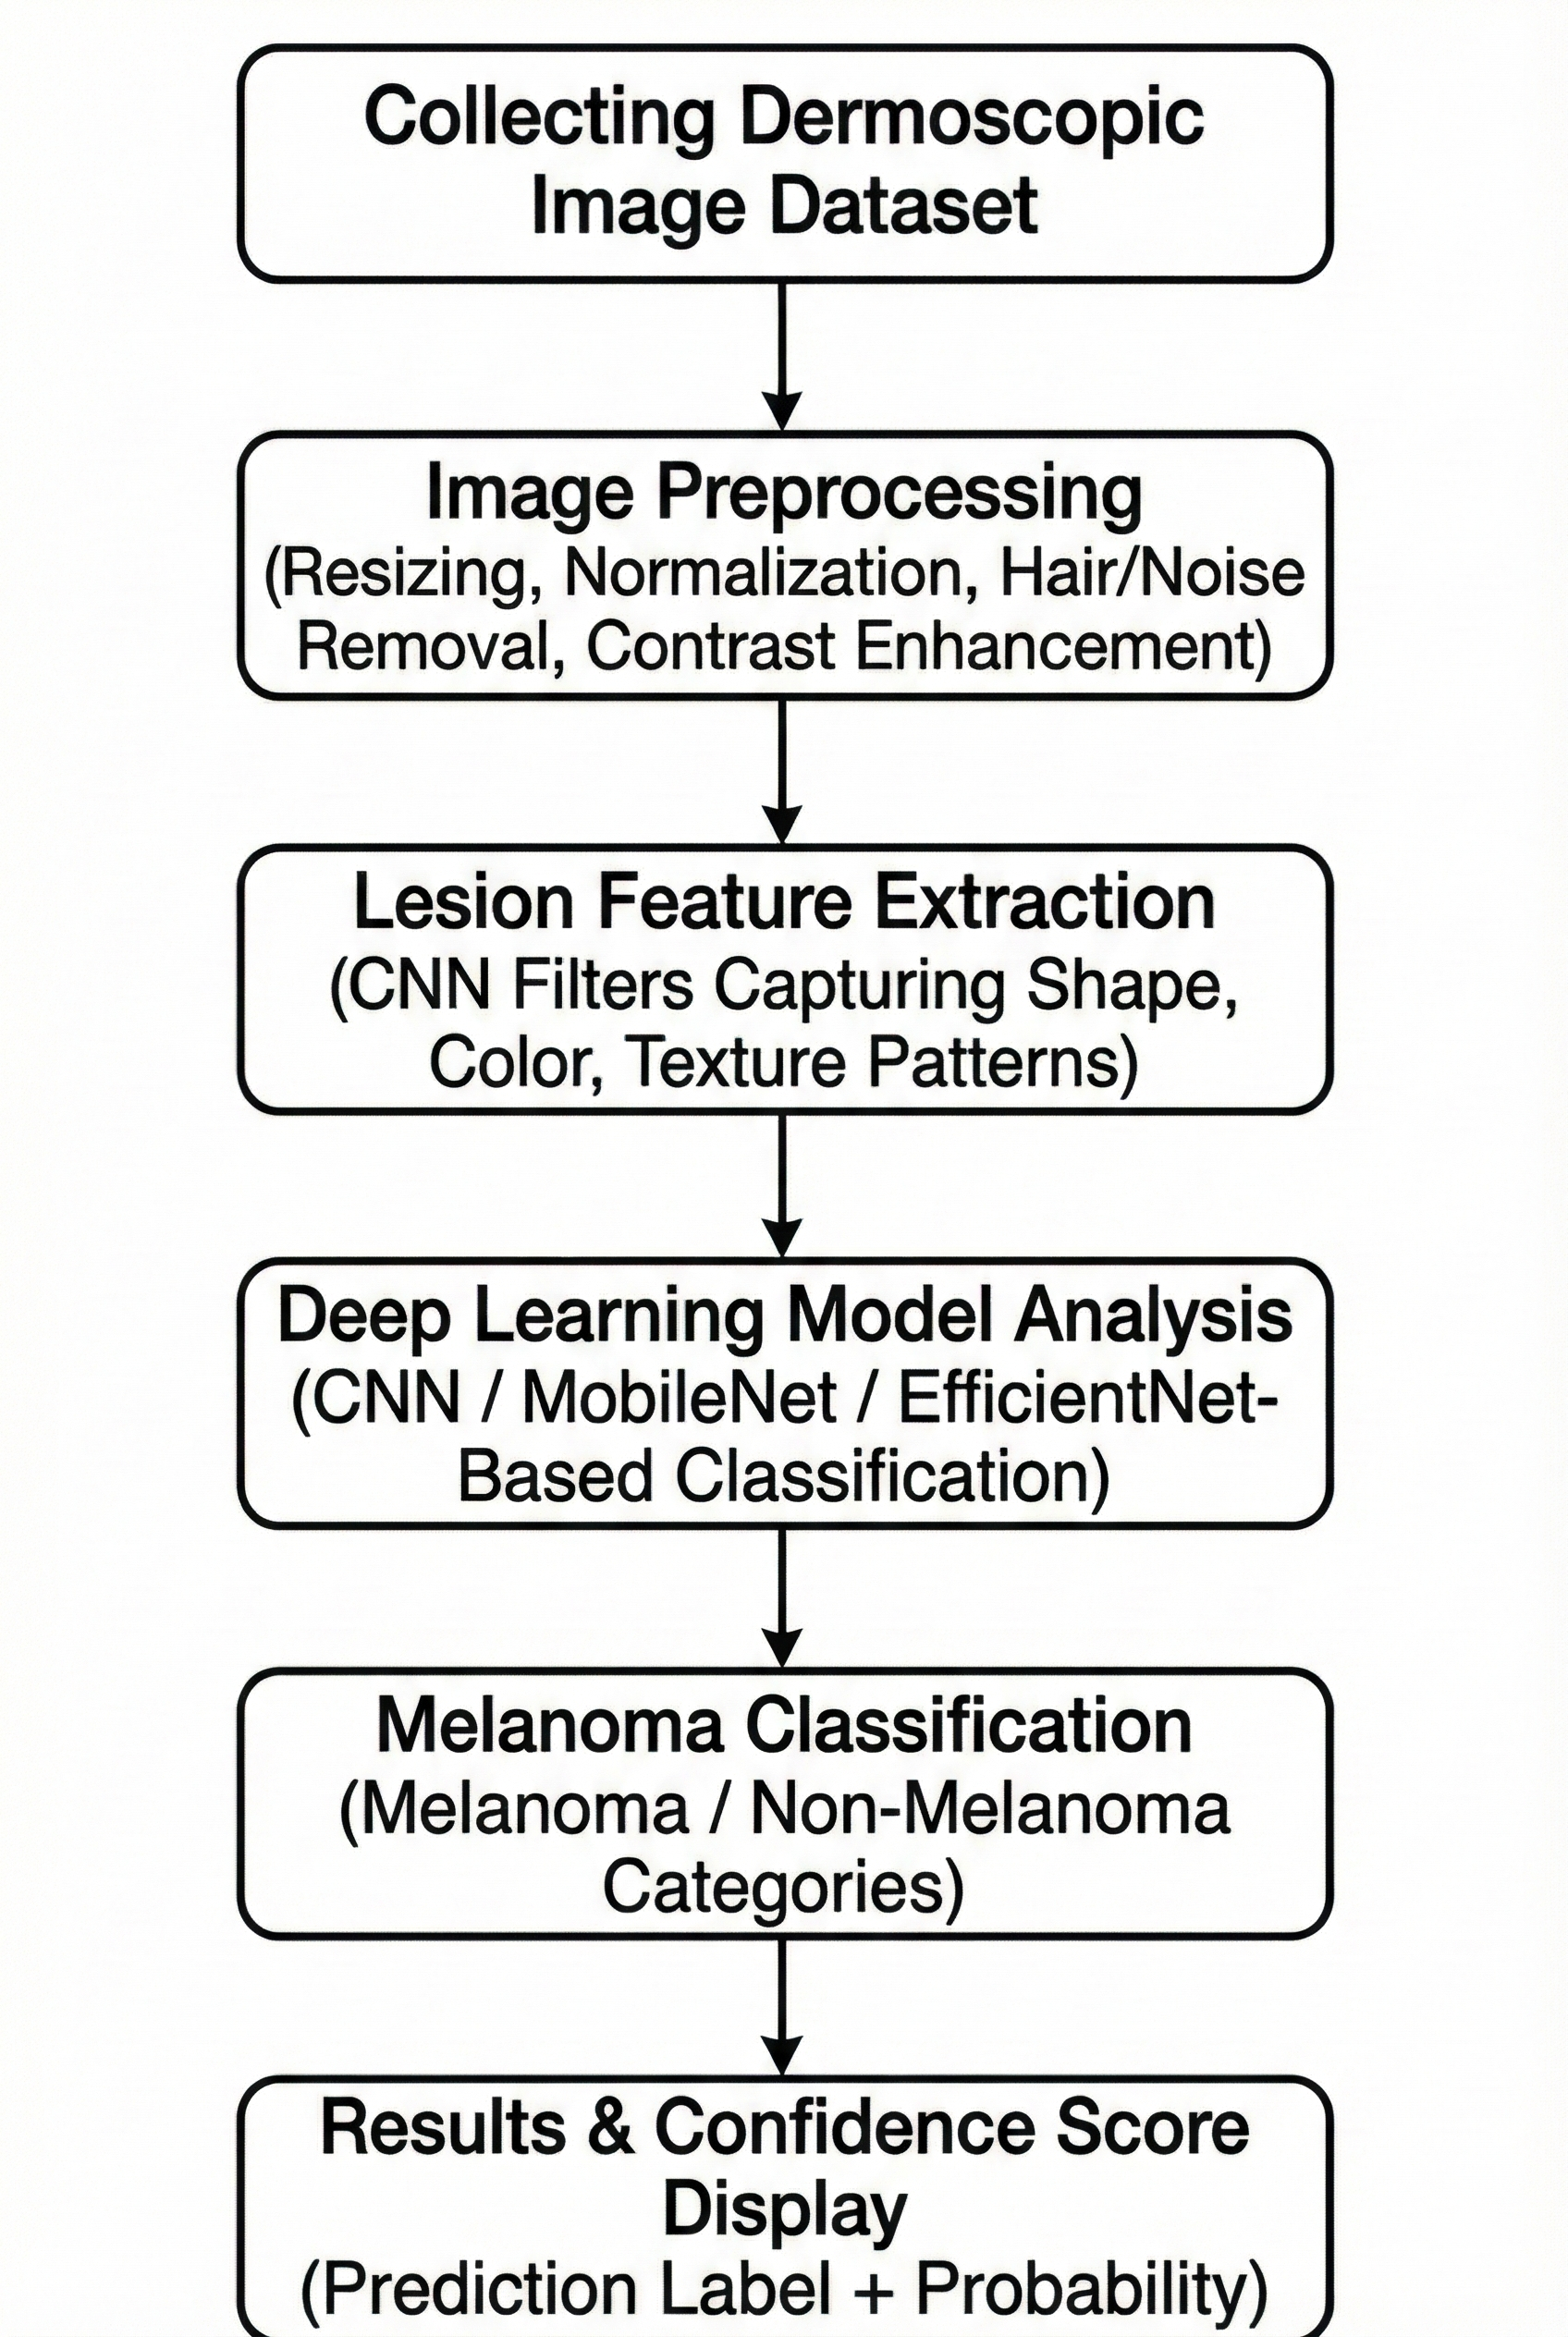
Design and Implementation

Slide 20
Design and Implementation
System Architecture Overview
Design – High-Level
The system follows a three–stage architecture: Image Acquisition → Image Processing → Deep Learning Classification
Dermoscopic images from datasets (HAM10000 / ISIC) serve as the input for model training.
Preprocessing modules standardize images using contrast normalization, artifact removal, and resizing.
A CNN-based classifier extracts hierarchical features and performs melanoma vs non-melanoma prediction.
Lightweight deployment is supported using MobileNet/EfficientNetLite, optimized for real-time mobile inference.
Output is displayed through a user-friendly interface (web/mobile) with prediction confidence.

Slide 21
Design and Implementation
Image Preprocessing Pipeline
Design – Image Processing
Images undergo resizing and normalization to maintain uniform input dimensions for the CNN.
Hair removal is performed using mathematical morphology to eliminate artifacts that hinder feature extraction
Contrast enhancement improves lesion boundary visibility and supports accurate segmentation.
Dataset augmentation (rotation, flip, brightness shift) increases image diversity and reduces overfitting.
ESRGAN/WGAN augmentation (from reviewed studies) inspired robust preprocessing techniques in our pipeline.

Slide 22
Design and Implementation
Deep Learning Model Architecture
Design – CNN Model
The core classifier is built using Convolutional Neural Networks, trained to differentiate melanoma from benign lesions.
CNN includes feature extractors (conv + pooling), followed by fully connected layers and sigmoid output for binary classification.
Transfer learning using MobileNet/EfficientNetLite improves performance on smaller datasets with fewer parameters.
Activation functions (ReLU), dropout, and batch normalization ensure stable learning and generalization.
Final layer uses binary cross-entropy as the loss function for melanoma classification.

Slide 23
Design and Implementation
Model Training & Optimization
Implementation – Training Strategy
Training performed using Adam optimizer with dynamic learning-rate adaptation for stable convergence.
Early stopping monitors validation loss to prevent overfitting and restore best weights.
Learning rate reduction callback helps stabilize performance when improvements plateau.
Training conducted on GPU-backed environment (Colab) for faster computation and model refinement.
Performance evaluated using accuracy, AUC-ROC, precision, recall, and F1-score.

Slide 24
Design and Implementation
Deployment Workflow (Mobile + Web)
Implementation – Deployment
Final trained model converted to TensorFlow Lite (.tflite) for optimized mobile performance and reduced size.
On-device inference ensures privacy (no cloud upload), low latency, and offline usability.
Android Studio used to integrate the TFLite model within the mobile UI (Java/Kotlin).
Web deployment through Flask/HTML enables browser-based image upload and prediction.
Both deployment modes deliver classification results with lesion probability score.

Slide 25
Design and Implementation
End-to-End System Workflow
Design + Implementation
Step 1: User captures or uploads a dermoscopic image (mobile/web).
Step 2: Image is preprocessed (artifact removal, standardization).
Step 3: Preprocessed image passed to TFLite/CNN model for melanoma prediction.
Step 4: Model outputs probability score and classification label.
Step 5: Result displayed instantly with an option to retest or save.
Step 6: System supports real-time, offline, privacy-safe diagnostics aligned with healthcare standards.

Slide 26
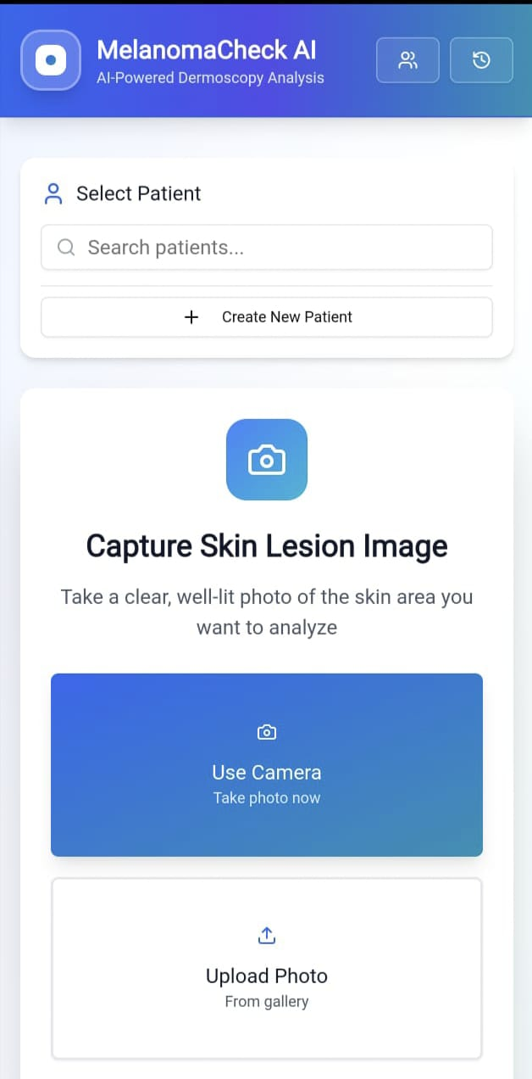
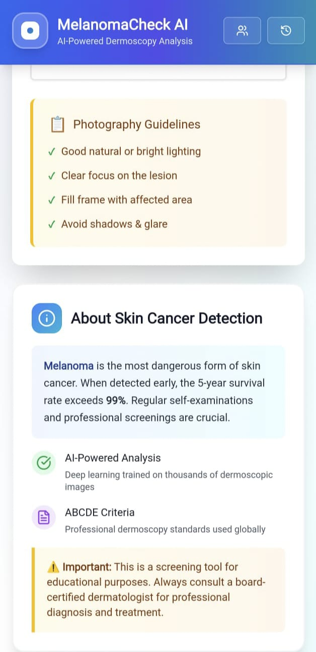
Results

Slide 27
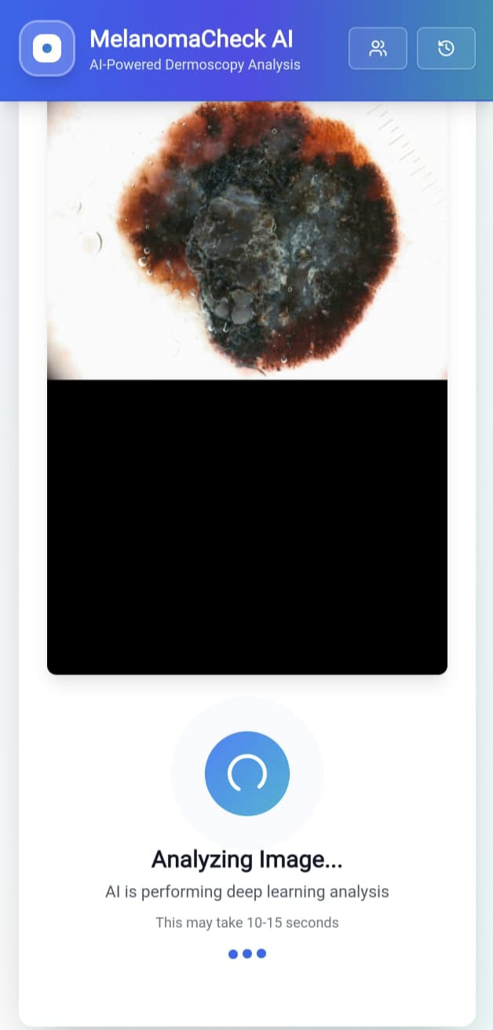
Results

Slide 28
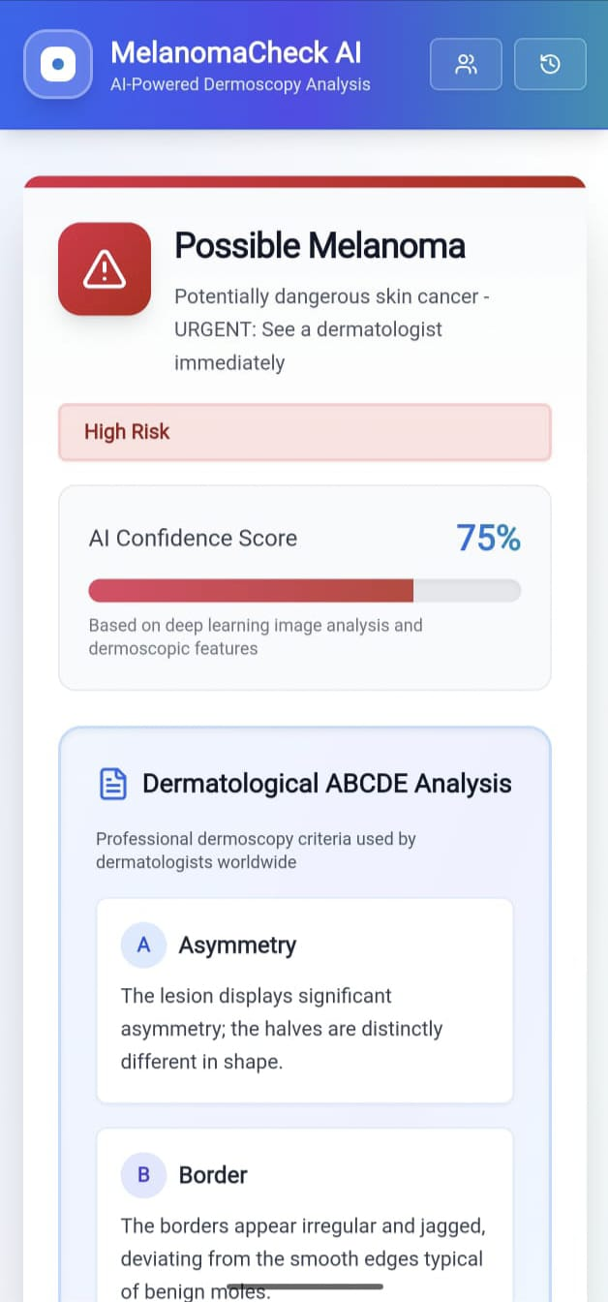
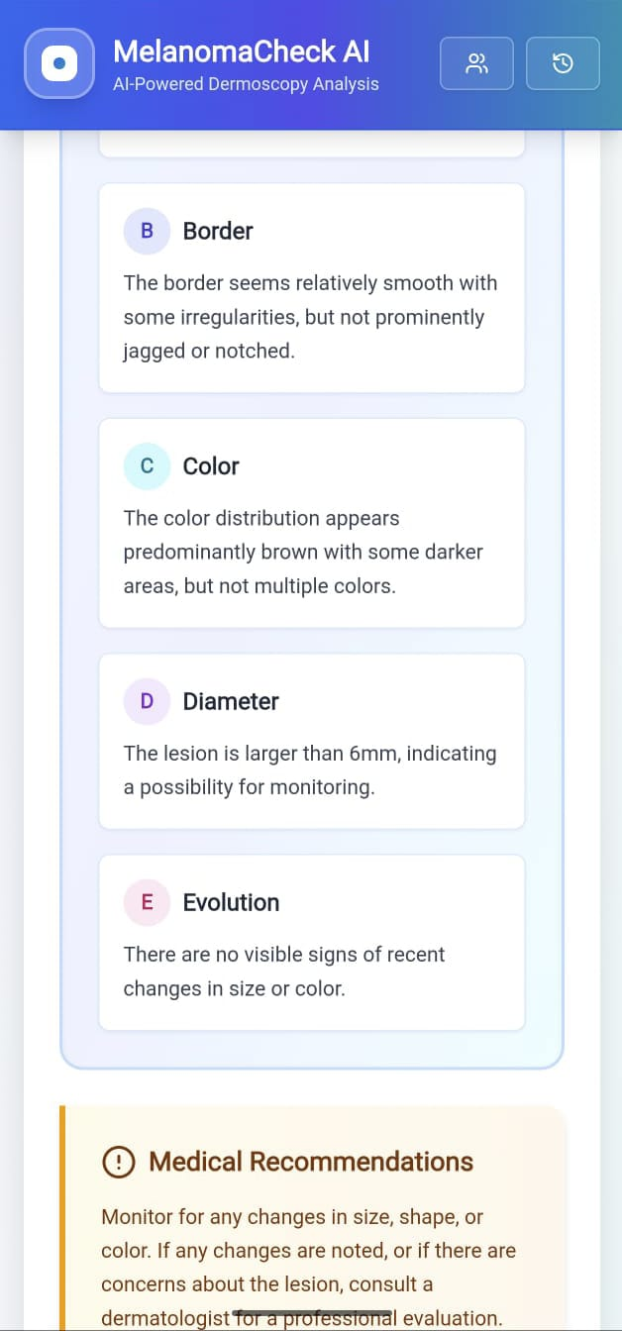
Results

Slide 29
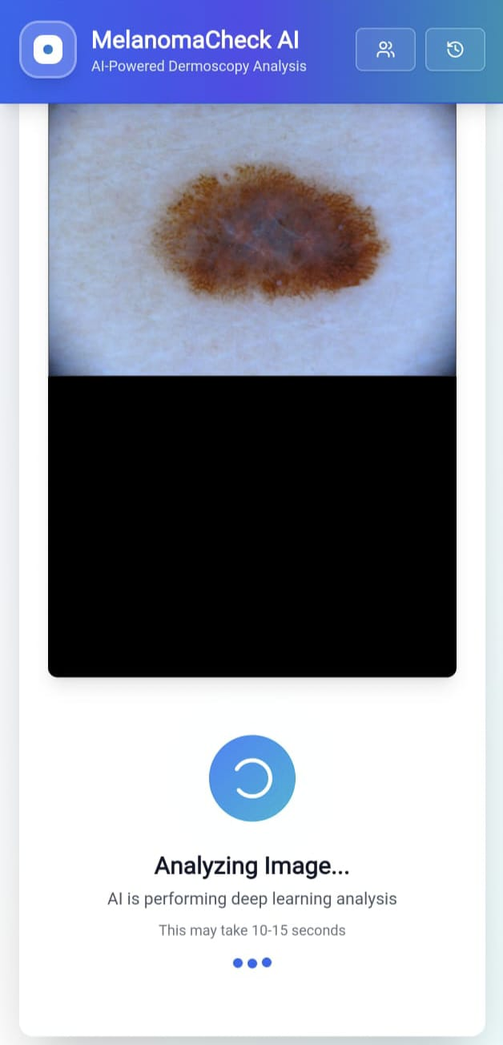
Results

Slide 30
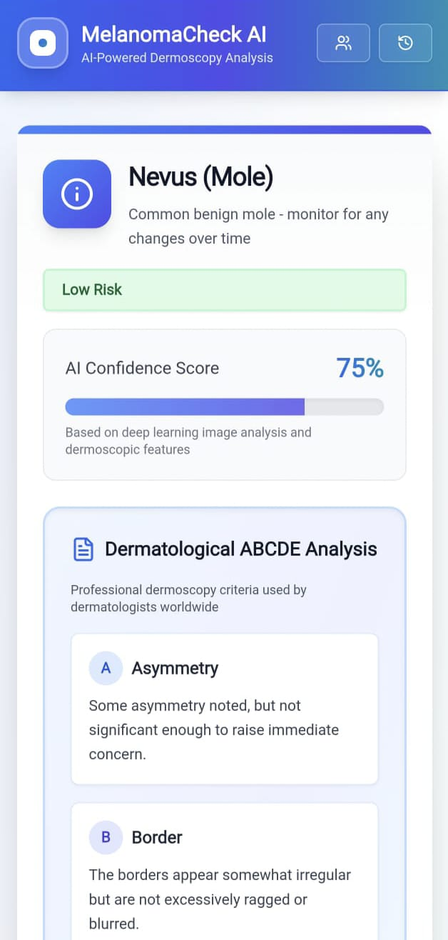
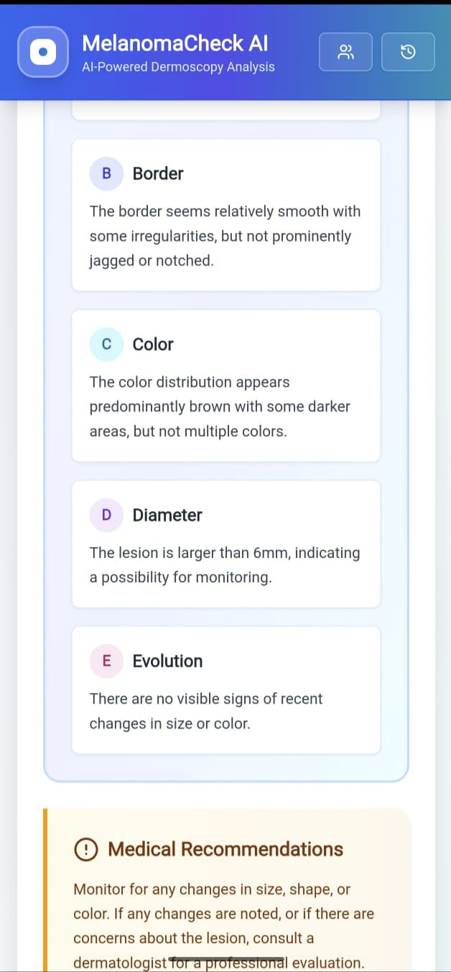
Results

Slide 31
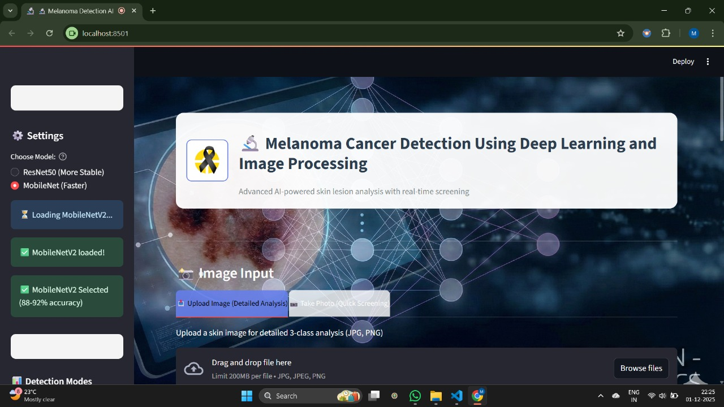
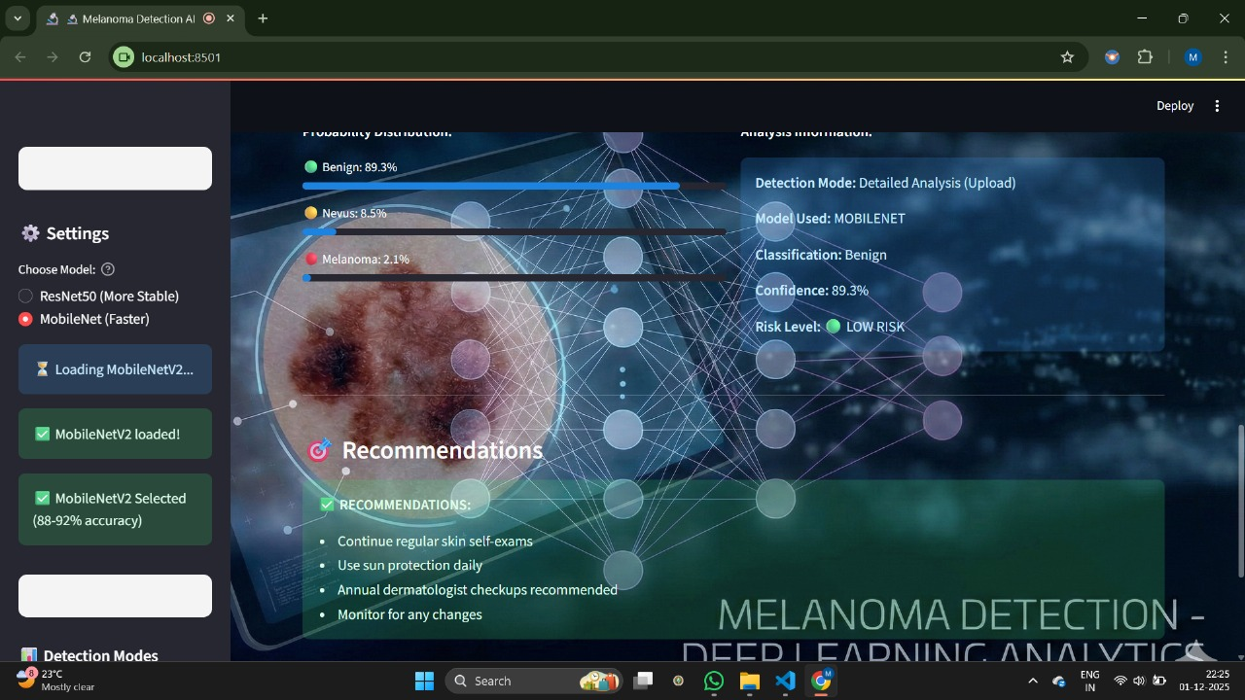
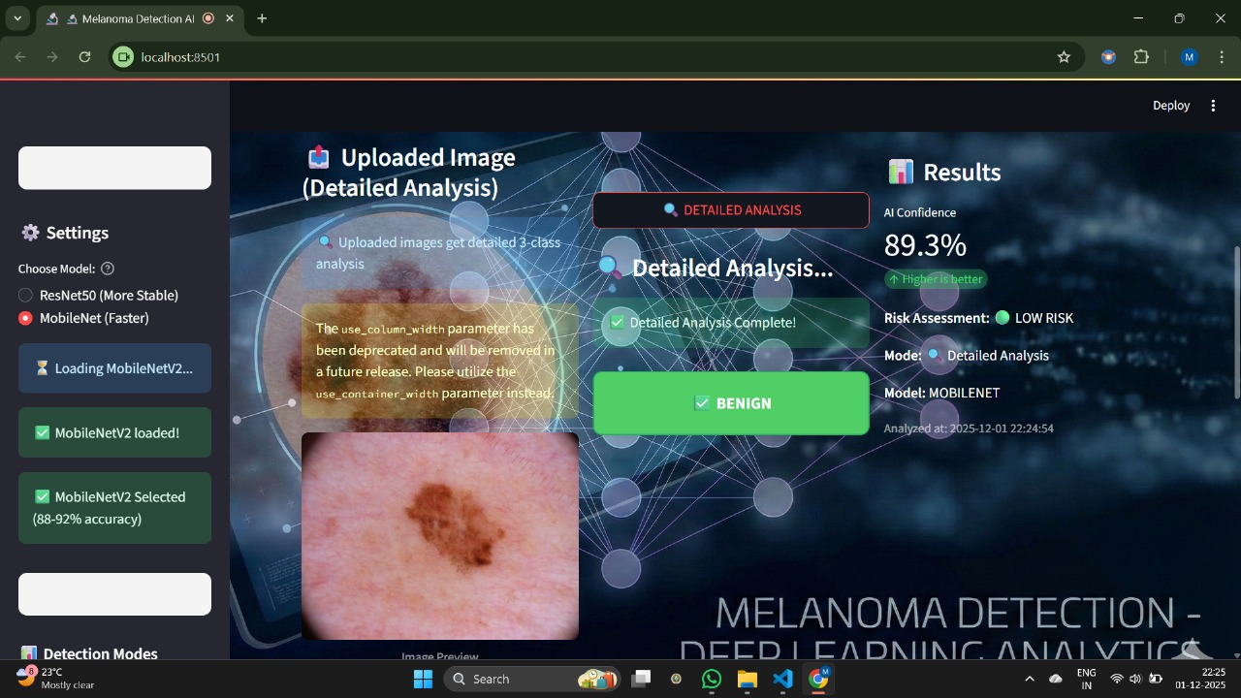
Results

Slide 32
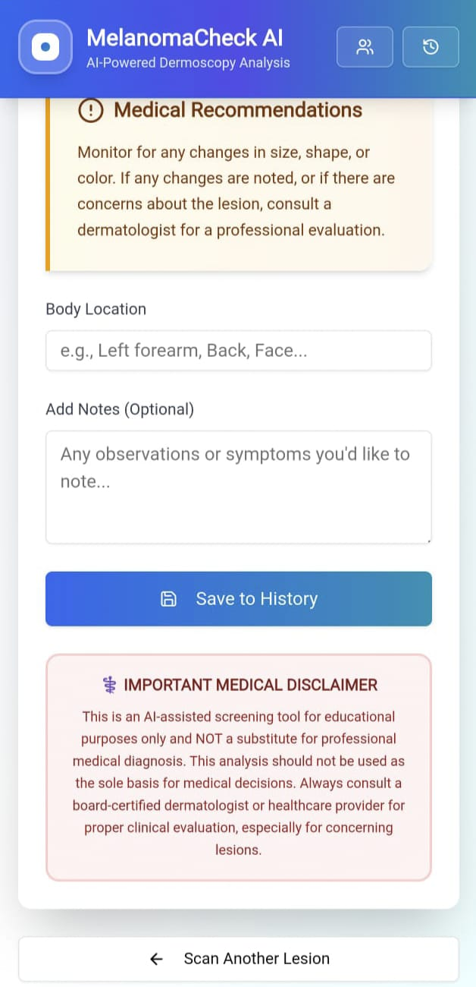
Results

Slide 33
Discussions
ADVANTAGES
The system provides quick and reliable melanoma predictions, helping reduce delays in early diagnosis.
Image preprocessing enhances lesion clarity, enabling the model to detect subtle patterns more consistently.
CNN-based analysis reduces dependence on manual interpretation and supports dermatologists with a dependable diagnostic aid.
Lightweight model deployment ensures fast, on-device inference, offering smooth performance even on limited hardware.
The clean and simple interface makes the platform convenient and easy to operate in clinical and non-clinical settings.
USER EXPERIENCES & FEEDBACK
The interface is intuitive and requires only a single image upload to obtain results effortlessly.
Clear output labels and confidence scores make the prediction easy to understand for anyone using the system.
The online platform provides a smooth experience with fast processing and minimal waiting time.
The system operates consistently across different devices without requiring additional configuration.
The tool helps increase awareness of skin lesion risks and encourages timely clinical consultation when suspicious patterns are detected.

Slide 34
Discussions
Limitations
Accuracy may reduce when images are captured under poor lighting, with blur, or containing strong artifacts.
Dataset imbalance and limited representation of rare melanoma variations can affect overall generalization.
Although multiple melanoma-related classes are supported, prediction consistency for all lesion types can vary based on dataset quality.
Variations in camera sensors, skin tones, and imaging conditions may influence real-world performance and require additional tuning.

Slide 35
Conclusion
Melanoma Detection Using Deep Learning and Image Processing is a practical and impactful framework designed to support early identification of melanoma through intelligent automation. By combining advanced CNN-based analysis with enhanced dermoscopic image preprocessing, the system delivers accurate lesion classification and improved clarity in identifying cancer-prone patterns. Its online platform ensures accessible predictions, intuitive interaction, and consistent performance across devices, making it suitable for both clinical assistance and public screening. This solution encourages proactive health evaluation, supports decision-making for dermatology professionals, and demonstrates how AI-driven medical tools can enhance early diagnosis. Ultimately, the project contributes to improved healthcare awareness, timely intervention, and more reliable melanoma risk assessment.

Slide 36
Conclusion
Future Scope :
1. Multi-Class & Multi-Stage Diagnosis
Expanding the system to detect multiple categories of skin lesions, identify early-to-advanced melanoma stages, and support broader dermatological screening.
2. AI-Driven Personalized Risk Assessment
Incorporating patient-specific factors such as age, skin type, medical history, and environmental exposure to generate personalized melanoma risk scores for more precise recommendations.
3. Clinical Dataset Expansion
Improving generalization by training on larger real-world datasets from hospitals, covering diverse skin tones, imaging devices, and rare melanoma variants.
4. Real-Time Guided Image Capture
Integrating intelligent camera assistance that guides individuals on how to capture high-quality dermoscopic images, reducing noise, improving clarity, and ensuring more accurate predictions during live scanning.

Slide 37
Bibliography
[1]. S. A. Arani, Yu Zhang, M. Tanvir Rahman & Hui Yang. (2022). “Melanlysis: A Mobile Deep Learning Approach for Early Detection of Skin Cancer,” Computers in Biology and Medicine, vol. 145, 105446, pp. 1–9. Elsevier.
[2]. Mateen, M., Yasin, A., Kanwal, N., & Ganaie, M. A. (2024). “Hybrid Deep Learning Framework for Melanoma Diagnosis Using Dermoscopic Medical Images,” Diagnostics, vol. 14, no. 2242, pp. 1–21. MDPI.
[3]. Olusoji Akinrinade, Chunglin Du . (2024). “Skin Cancer Detection Using Deep Machine Learning Techniques,” Biomedical Signal Processing and Control, vol. 91, pp. 1–12. ScienceDirect.
[4]. Dr.Irala Suneetha. (2024). “Hybrid Deep Learning Model for Skin Cancer Classification,” E3S Web of Conferences – ICRERA 2024, vol. 441, 09010, pp. 1–6. EDP Sciences.
[5]. Peng Zhang, Divya Chaudhary. (2024). “Hybrid Deep Learning Framework for Enhanced Melanoma Detection,” arXiv preprint, arXiv:2408.00772.
[6]. Kreouzi, I., Papageorgiou, E., Skourletopoulos, G., & Vlahavas, I. (2025). “Deep Learning for Melanoma Detection: A Deep Learning Approach to Differentiating Malignant Melanoma from Benign Melanocytic Nevi,” Cancers,
vol. 17, no. 28, pp. 1–22. MDPI.
[7]. Ghadah Alwakid , Walaa Gouda. (2022). “Melanoma Detection Using Deep Learning-Based Classifications,”Healthcare,vol. 10, no. 2481, pp. 1–18. MDPI.
[8]. S Devaraneni,(2023). “Melanoma Detection Based on Deep Learning Networks,” Master’s Thesis, California State University, San Bernardino. ProQuest..
[9]. Devika Moturi, R K Surapaneni, and V S G Avanigadda (2024), “Developing an Efficient Method for Melanoma Detection Using CNN Techniques,” Journal of the Egyptian National Cancer Institute, vol. 36, no. 6, 2024. SpringerLink+1.
[10]. Vikas Khullar, Prabhjot Kaur, Shubham Gargrish, Anand Muni Mishra, Prabhishek Singh and Indrajeet Gupta (2025), “Minimal Sourced and Lightweight Federated Transfer Learning Models for Skin Cancer Detection,”
Scientific Reports, vol. 14, no. 1, 2024, article 82402. Nature+1.

Slide 38
Bibliography
[11]. Górecki, S., Duszczyk, W., Huda,Faryna.A.& Tatka, A., “Web-based Melanoma Detection System Using Convolutional Neural Networks and Advanced Image Processing,” Proceedings of the 7th International Conference on Informatics & Data-Driven Medicine (IDDM’24), Birmingham, UK, 2024. CEUR-WS+1.
[12]. N J F Jaber, A Akbas (2025), “Diagnosis and Prognosis of Melanoma from Dermoscopy Images Using Machine Learning and Deep Learning: A Systematic Literature Review,” BMC Cancer, vol. 24, no. 1, 2024, article 13423. BioMed Central+1.
[13]. Faisal, M. T., & Akbas, M. I., “Melanoma Skin Cancer Detection Based on Deep Learning Methods and Binary Harris Hawk Optimization,” BiomedInformatics, vol. 4, no. 1, 2024, pp. 121–135. MDPI+1.
[14]. El-Khatib, M., Rizwan, M., “Melanoma Skin Cancer Classification Using Deep Convolutional Neural Networks,” Diagnostics, vol. 13, no. 19, 2023, article 1911. MDPI+1.
[15]. Jaya, R. V., “Skin Cancer Detection Using Convolutional Neural Networks and Classification Techniques,” Journal of Computing and Communication (JOCC), vol. 3, no. 1, 2023, pp. 22–32. JOCC+1. [16]. Q Zou, J Cheng, and Z Liang (2023), “Automatic Diagnosis of Melanoma Based on EfficientNet and Patch Strategy,” Healthcare Analytics, vol. 5, 2024, pp. 100–112. Elsevier+1.
[17]. F Rundo, G L Banna and S Conoci(2019), “Bio-Inspired Deep-CNN Pipeline for Skin Cancer Early Diagnosis,” Computation, vol. 7, no. 44, 2019. MDPI+1
[18]. S S Zareen, Guangmin Sun, M Kundi, S F Qadri and Salman Qadri, “Enhancing Skin Cancer Diagnosis with Deep Learning: A Hybrid CNN-RNN Approach,” Traitement du Signal, vol. 40, no. 4, 2023, pp. 749–756. IFAC/EDP Sciences+1.
[19]. C. K. Viknesh, P. Nirmal Kumar, R. Seetharaman, and D. Anitha (2023), “Detection and Classification of Melanoma Skin Cancer Using Image Processing Technique,” Journal of Xi’an University of Architecture & Technology, vol. XII, no. IV, 2020, pp. 1186–1192. JXUAT+1.
[20]. Carolina Magalhaes Joaquim Mendes and Ricardo Vardasca (2024),“A Systematic Review of Deep Learning Techniques for Skin Lesion Analysis,” Diagnostics, vol. 13, no. 19, 2023, article 1911. MDPI+1

Slide 39
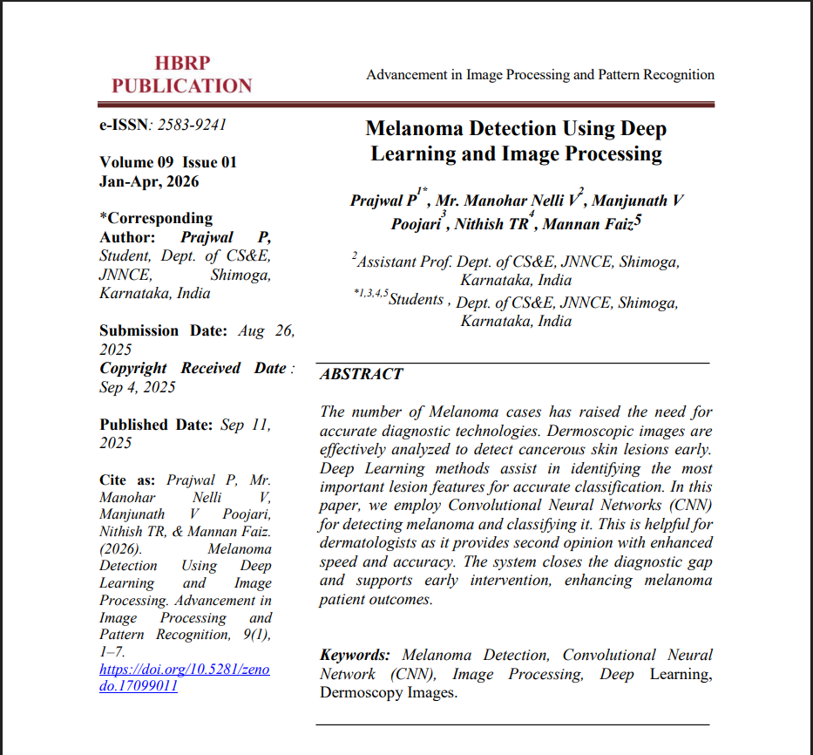
Paper Published
Melanoma Detection Using Deep Learning and Image Processing (HBRP)

Slide 40
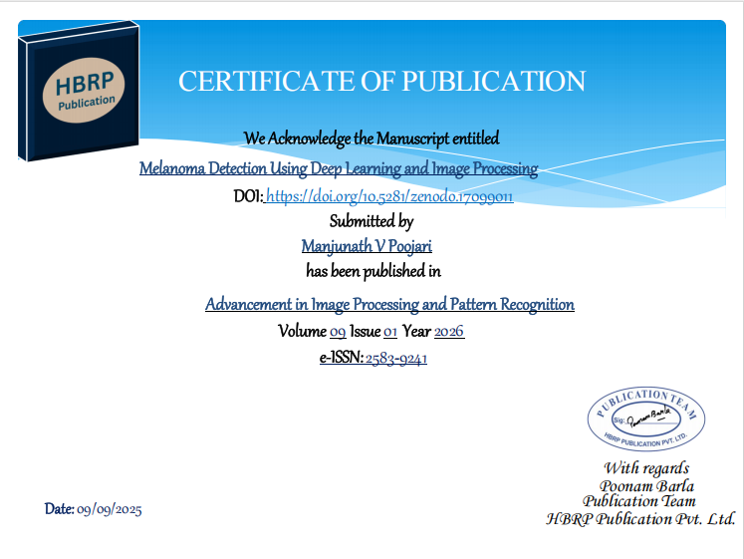
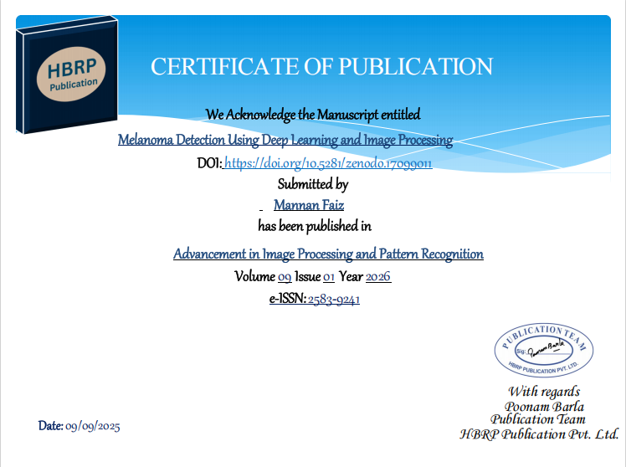

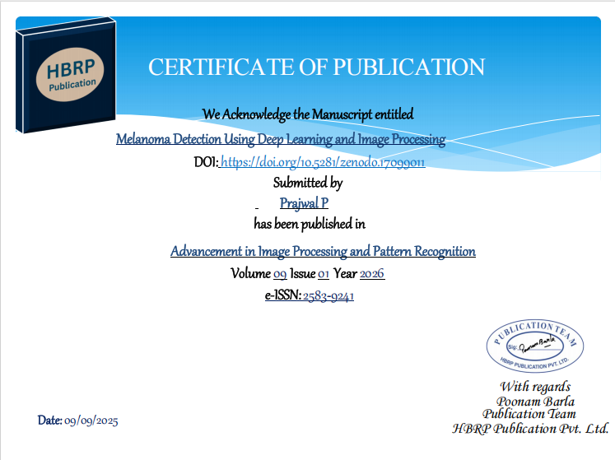
Certificates

Slide 41
THANK YOU

